Slide 1
Variation in the R-word ER in quantitative constructions in regional (Heerlen) Dutch
Workshop “Methods for approaching variation: partitives and beyond” Karoli Gaspar University, Budapest, 16-17 September 2022
Leonie Cornips¹, Petra Sleeman²
1 NL-Lab, KNAW 2 University of Amsterdam

Slide 2
Introduction

Slide 3
European languages
Some of the European languages have a partitive (quantitative) pronoun, whereas most of the standard European languages do not have one:
(1) Jean en a trois ‘Jean has three’ (French)
(2) Gianni ne ha tre. ‘Gianni has three’ (Italian)
(3) Jan heeft er drie. ‘Jan has three’ (Dutch)
(4) Si huet der dräi. ‘She has three’ (Luxembourgish)
(5) Jan hat drei. ‘Jan has three’ (Standard German)
(6) Hy hat trije. ‘Hij has three’(Frisian)

Slide 4
Quantitative ER in standard Dutch
Dutch Reference Grammar 1997 (Electronic version 2012):
Quantitative ER is used with a quantifying expression, it refers to a countable entity:
Context: (Waar zijn de boeken?)
‘Where are the books?’
(7) Ik vind er maar drie ( Ø)
I find ER only three
‘I can only find three.’

Slide 5
Regional variation
There is regional variation in the contexts in which the Dutch and German quantitative pronouns can be used (Glaser 1993, Sleeman 1998; Cornips 2003; Strobel 2017)
We focus in this presentation on regional standard Dutch: Heerlen Dutch.

Slide 6
Our goal
To study how Q(uantitative)-ER is used in spoken Heerlen Dutch
To analyze how sociolinguistic background and linguistic context influence the absence or presence of Q-ER in spoken Heerlen Dutch
To explain variation linguistically and sociolinguistically (social stratification)

Slide 7
Background

Slide 8
Quantitative ER in Netherlandic standard Dutch
Presence of ER with quantificational expressions specifying a quantity:
(8) Ik eet ER drie (9) *Ik eet Ø drie
I eat ER three I eat three
‘I eat three’ ‘I eat three’

Slide 9
Quantitative ER in Netherlandic standard Dutch
Absence of ER with quantificational expressions specifying age (Sleeman 2022):
(10) Zij is Ø tachtig (11) *Zij is ER tachtig
She is eighty She is ER eighty
‘She is eighty’ ‘She is eighty’

Slide 10
Netherlandic standard Dutch
+ ER with quantity
‒ ER with age

Slide 11
Methodology

Slide 12
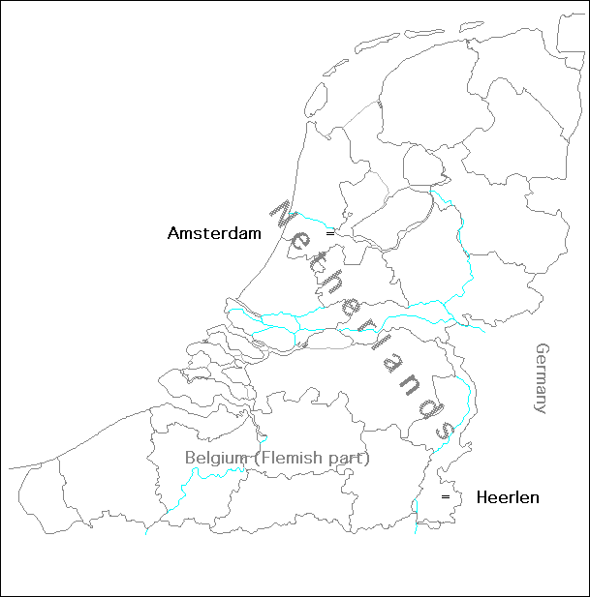
Introduction of the corpus

Slide 13
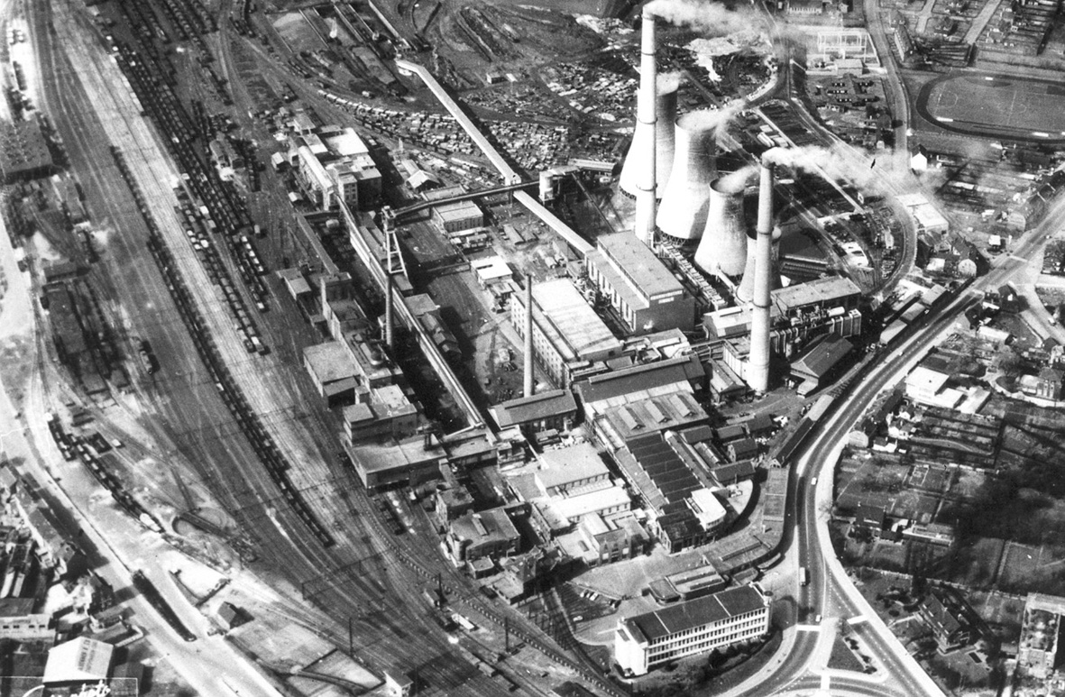
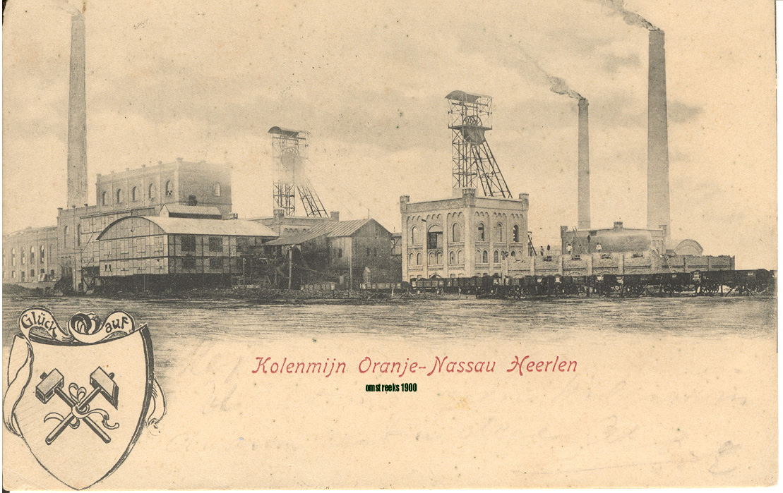
Heerlen Dutch
Heerlen Dutch
Regional variety of standard Dutch
Exists together with dialect
Explosion coalmines 1900-1930
Many migrant speakers from within and outside the Netherlands

Slide 14
Heerlen Dutch corpus
Data collected and transcribed by Leonie Cornips
Collected between 1989-1991
Cornips (1994)
33 dialogues and 1 monologue
33,5 hours of spoken Heerlen Dutch
67 participants born in Heerlen

Slide 15
Heerlen Dutch corpus: 33,5 hours of recorded spontaneous speech
 | low level of education |  | high level of education |  | total
L1’s/2L1 | young | old | young | old
*migrant *dialect *Heerlen Dutch | 3 5 8 | 6 6 0 | 5 8 8 | 5 10 3 | 19 29 19
total | 16 | 12 | 21 | 18 | 67

Slide 16
Searching the corpus
cardinals 1-100
aardig wat “quite a few”
een heleboel “a lot”
een aantal “a couple”
een beetje “a little”
een paar “a few”
ene/een “one”
enige “several”
geen “no”
genoeg/zat “enough”
meerdere “several”
enkele “some”
veel/vele “much/many”
verschillende “several”
voldoende “sufficient”
wat “some”
weinig “little”
meer “more”
jaar “years”
kilo “kilograms”

Slide 17
Different forms of ER
These forms also exist in standard Dutch and occur many times in the corpus:
er
d’r
‘r

Slide 18
Type/Tokens
Form | Quantity
er | 79
d’r | 56
’r | 2
other | 1

Slide 19
Data requirements
No nouns involved:
(12) dan zijn ER twee dingen die zijn belangrijkste
then are ER two things that are most important
‘then there are two things that are the most important ones’
(Tape 12, Anton)
No ambiguity

Slide 20
Five types of ER
Dutch has different types of ER (Bennis 1986; Grondelaers 2009):
Existential: ER is een probleem. ‘There is a problem.’
Expletive: ER werd gedanst. ER is being danced. ‘There is dancing going on.’
Locative: I was ER ook. I was ER too. ‘I was there too.’
Prepositional: Ik denk ERaan. I think ERof. ‘I think of it.’
Quantitative: Hij heeft ER vijf. He has ER five. ‘He has five.’

Slide 21
Data requirements: no ambiguity
Unsure which type of ER? → deletion of the utterance
(13) te huur zijn ER nog twee
for rent are ER still two
two more are ER for rent” (Tape 3, Jansen)
Also possible:
(14) ER zijn ER nog twee te huur
THERE are ER still two for rent”
‘there are two left for rent’

Slide 22
Results

Slide 23
Quantitative construction
(15) daar zaten D’R ook maar heel weinig (Tape 3, Gies)
there were-sitting ER also only very few
‘also there, there were only very few’
(16) dus ik heb ook geen gekregen (Tape 11, Huls)
thus I have also none received
‘therefore I received also none’

Slide 24
Age (and weight)
(17) ik was twintig (Tape 20, Jeroen)
‘I was 20’
(18) die is D’R zevenentwintig (Tape 35, Arends)
that-one is ER twenty-seven
‘(s)he is 27’
(19) ik was zesenzeventig kilo toen ik erin ging
I was seventy-six kilograms when I in went
en ik was ER vijfennegentig toen ik eruit kwam
and I was ER ninety-five when I out came
‘I weighed 67 kilograms when I went in and I weighed 95 when I came out’ (Tape 27, Dik)

Slide 25
Type/tokens
Quantitative | Quantitative | Age, weight | Age, weight
+ER (=NSD) | ‒ER | +ER | ‒ER (=NSD)
138 | 28 | 14 | 69
N=166 |  | N=83

Slide 26
Social stratification Q-ER? Absence Q-ER in numerator, potential (n) Q-ER in denominator
Presence Q-er n=138 Absence Q-er n=28 | low level of education |  | high level of education |  | Total N=166
L1’s/2L1 | young | old | young | old
migrant dialect Heerlen | 1/13 2/5 5/28 | 0/12 4/22 -- | 1/15 4/17 2/7 | 4/18 4/23 1/6
Language background (9%, 17%, 16%): x² = 1.514, df = 2, p-value = 0.469 Migrant vs. dialect (9%, 17%): x² = 1.881, df = 1, p-value = 0.170 Age: (Y 15%, O 14%) x²= 0.054, df = 1, p-value = 0.817 Education: (L 13%, H 16%) x²= 0.274, df = 1, p-value = 0.601 Pearson's Chi-squared test with Yates' continuity correction in R

Slide 27
Categorical and variable use Q-ER at the level of the individual speaker in Heerlen
Q-ER (n=166) | n speakers (n=54)
categorical present | 34 (64%)
categorical absent | 3 (6%)
variable use | 16 (30%)

Slide 28
Social stratification Age/Weight-ER? Presence ER in numerator, potential (n) ER in denominator
Presence ER n=14 Absence ER n=69 | low level of education |  | high level of education |  | Total N=83
L1’s/2L1 | young | old | young | old
*migrant *dialect *Heerlen Dutch | 1/2 1/1 0/5 | 1/13 3/5 -- | 0/3 0/16 1/7 | 0/5 7/19 0/7
Language background (8%, 21%, 5%): x² = 4.181, df = 2, p-value = 0.124 Dialect vs Heerlen Dutch (21%, 5%): x² = 2.715, df = 1, p-value = 0.099 Age (Y 8%, O 18%): x² = 1.938, df = 1, p-value = 0.164 Education (L 19%, H 12%): x² = 0.721, df = 1, p-value = 0.396 Pearson's Chi-squared test with Yates' continuity correction in R

Slide 29
Categorical and variable use age/weight ER at the level of the individual speaker in Heerlen
ER (n=83) | n speakers (n=39)
categorical present | 6 (16%)
categorical absent | 29 (76%)
variable use | 3 (8%)

Slide 30
Discussion

Slide 31
Sociolinguistic variation
Quantitative construction
Omission by all social stratified groups of speakers (age, education, language background)
Possibility of omission of ER seems to be a stable feature of Heerlen Dutch

Slide 32
Linguistic variation
What could explain omission in the quantificational construction:
Heerlen dialect? (not confirmed in small survey)
Migrants?
Analogy?
Expletive ER and prepositional ER can also be omitted

Slide 33
Linguistic variation
Omission of expletive ER (Cornips 2003):
(20) liefste ’s nachts als Ø geen maan was
preferably at night when no moon was
‘preferably at night when there was no moon’
Omission of prepositional ER (Cornips 2003):
(21) ’t ziet Ø niet uit
it looks not out
‘It looks bad’

Slide 34
Linguistic variation
Omission + variable use (3 + 16 participants):
9x dialect (4xL)
5x Heerlen Dutch (3xL)
5x migrant (1xL)
10xY + 9xO
Presence (34 participants)
12x dialect (9H)
8x Heerlen Dutch (4xH)
14x migrant (6xH)
16xY + 18xO

Slide 35
Sociolinguistic variation
Age/weight construction:
Presence especially in sociolinguistic groups:
Dialect
Older speakers
Lower education
Possibility of presence of ER with Age/weight does not seem to be a stable feature of Heerlen Dutch

Slide 36
Linguistic variation
What could explain presence in the age/weight construction:
Analogy?
ER is also used with omitted mass nouns or bare plurals (de Rooij 1991; de Schutter 1992):
(22) Wil jij D’R nog koffie?
Want you ER more coffee
‘Would you like some more coffee?’
Neighboring languages/dialects?
ER is also used with AGE in Belgian standard Dutch and in French

Slide 37
Quantitative ER in Belgian standard Dutch and French
Absence of ER with quantificational expressions specifying age in Belgian Dutch (Sleeman 2022):
(23) Zij is Ø tachtig (67%) (24)Zij is ER tachtig (93%)
she is eighty she is ER eighty
‘She is eighty’ ‘She is eighty’
(25) Elle EN a vingt.
‘she EN has twenty’
‘She is 20 years old.’

Slide 38
Linguistic variation
What could explain presence in the age/weight construction:
Heerlen dialect?
(26) Ich bèn DER tachtig. (Bep, dialect speaker)
I am ER eighty
‘I am eighty.’

Slide 39
Linguistic variation
Presence or variable use (6 + 3):
6x dialect (3x L)
1x Heerlen Dutch (0x L)
2x migrant (2x L)
3xY + 6xO
Absence (29):
9 x dialect (8x H)
10x Heerlen Dutch (7x H)
10x migrant (5x H)
15xY + 14xO

Slide 40
Linguistic analysis
Presence of ER with quantity (as in standard Dutch) or absence
Absence of ER with age/weight (as in standard Dutch) or presence

Slide 41
Quantificational construction
With quantity ER is used with all kinds of transitive verbs
ER is moved from (object) noun position
Has an anaphoric function
Takes its interpretation from its antecedent
If absent, analyzed as empty pronoun
Empty pronoun has an anaphoric function
Movement of empty pronoun

Slide 42
Quantificational construction
ER is moved from (object) noun position
Movement of empty pronoun
(27) *Ik denk (ER) aan drie.
I think ER about three
‘I am thinking of three.’

Slide 43
Age in Netherlandic standard Dutch
Absence of ER with quantificational expressions specifying age (Sleeman 2022):
(28) Zij is Ø tachtig (93%) (29) Zij is ER tachtig (0%)
she is eighty she is ER eighty
‘She is eighty’ ‘She is eighty’

Slide 44
Weight in Netherlandic standard Dutch
Optionality of ER with quantificational expressions specifying weight (Sleeman 2022):
(30) Zij weegt Ø 60 (67%) (31) Zij weegt ER 60 (47%)
she weighs sixty she weighs ER sixty
‘She weighs sixty kgs’ ‘She weighs sixty kgs’
Analysis as intransitive or transitive verb.

Slide 45
Age/weight in Heerlen Dutch
With age and weight the verb is ‘to be’
With ER a transitive verb?
Analysis of ‘to be’ as a copula
Other copulas: worden ‘will be’, lijken ‘seem’
(32) ik ben ik word er nou tweeënzeventig
I am I will-be ER now seventy-two
‘I am, I will be now seventy-two.’

Slide 46
Age/weight in Heerlen Dutch
Movement of ER from the predicate NP
(33) “Is hij een dief?” “Ja, hij is ER één.”
is he a thief yes he is ER one
‘ “Is he a thief?” ’ ‘ “Yes, he is one.” ’

Slide 47
Age/weight
Without ER, is ‘to be’ an intransitive verb?
Analysis of ‘to be’ as a copula
(34) Hij is oud / negentig jaar.
‘He is old / ninety years.’
Other copulas: worden ‘will be’, lijken ‘seem’
(35) Ze wordt / lijkt achttien (jaar).
‘She will be / seems eighteen (years old).’
Movement of empty pronoun from the predicate NP.

Slide 48
Age/weight
(Empty) pronoun can have an anaphoric function:
(36) ik was zesenzeventig kilo toen ik erin ging
I was seventy-six kilograms when I in went
en ik was ER vijfennegentig toen ik eruit kwam
and I was ER ninety-five when I out came
‘I weighed 67 kilograms when I went in and I weighed 95 when I came out’ (Tape 27, Dik)
Or no anaphoric function:
(37) want mijn vrouw is ER ook al achtenzestig
for my wife is ER also already eighty-six
‘for my wife is also already eighty-six’ (Tape 28, Zink)

Slide 49
Conclusion

Slide 50
Conclusion
Heerlen Dutch presents stable social variation with respect to use of Q-ER
Use of age/weight-ER is decreasing (for younger speakers)
No errors, but typological features of Heerlen Dutch
Also present in other languages
Different linguistic analyses for the two constructions
Influence of dialect, analogy, other languages?
More research is needed

Slide 51
THANK YOU!

Slide 52
References
Bennis, H. (1986). Gaps and Dummies. Dordrecht: Foris Publications.
Coppen, P., W. Haeseryn & F. De Vriend (2012). Electronic ANS (Algemene Nederlandse Spraakkunst, Dutch Reference Grammar).
Cornips, L. (1994). Syntactische variatie in het Heerlens Nederlands. ‘Syntactic variation in Heerlen Dutch’ Unpubl. Diss, IFOTT, UvA
Cornips, L. (2003). Heerlens Dutch. Den Haag: SDU.
Glaser, E. (1993). Syntaktische Strategien zum Ausdruck von Indefinitheit und Partitivität im Deutschen (Standardsprache und Dialekt). In Werner Abraham & Josef Bayer (eds.), Dialektsyntax, 99-116. Opladen: Westdeutscher Verlag.
Grondelaers, S. (2009). Woordvolgorde in presentatieve zinnen en de theoretische basis van multi-factoriële grammatica. Nederlandse Taalkunde, 14.3, 282-299.

Slide 53
References
Rooij, J. de. (1991). Regionale variatie en gebruik van ER II. Taal en Tongval 43, 18-46.
Schutter, G. de. (1992). Partitief of kwantitatief ER, of over de verklaring van syntactische variatie. Taal en Tongval 44.1, 15-26.
Sleeman, P. (1998). The quantitative pronoun ER in Dutch dialects. In: S. Barbiers, J. Rooryck en J. van de Weijer (eds.), Small words in the big picture, Squibs for Hans Bennis. Leiden: Holland Institute of Generative Linguistics. 107 - 111.
Sleeman, P. (2022). Partitive pronouns in intransitive contexts in Italian and Dutch. Linguistic Variation, 1-27.
Strobel, T. (2017). Pronominale Partitivität. Arealität und Mikrovariation einer morphosyntaktischen Variable in den Varietäten des Deutschen. PhD Dissertation, Goethe University Frankfurt.

Slide 54
Quantitative ER in regional Dutch
Dutch Reference Grammar 1997 (Electronic version 2012)
Regional varieties of Dutch (southern):
Do you want coffee?
(7) Nee, ik heb ER nog. No I have ER still. ‘No, I still have some.’
Do you have roses?
(8) Ik heb ER witte en rode. I have ER white and red. ‘I have white and red ones.’

Slide 55
Quantitative ER in Belgian standard Dutch
Presence of ER with quantificational expressions specifying a quantity (Sleeman 2022):
Ik heb ER drie (98%) Ik eet Ø drie (18%)
I eat ER three I eat three
‘I eat three’ ‘I eat three’

Slide 56
Quantitative ER in Belgian standard Dutch
Absence of ER with quantificational expressions specifying age (Sleeman 2022):
Zij is Ø tachtig (67%) Zij is ER tachtig (93%)
She is eighty She is ER eighty
‘She is eighty’ ‘She is eighty’

Slide 57
Quantitative ER in Belgian standard Dutch
Absence of ER with quantificational expressions specifying weight (Sleeman 2022):
Zij weegt Ø zestig (60%) Zij weegt ER zestig (93%)
She weighs sixty She weighs ER sixty
‘She weighs sixty kgs’ ‘She weighs sixty kgs’

